Slide 1

PATHMA SHREE S R
NAME GENERATION USING RNN

Slide 2
NAME GENERATION USING RNN

Slide 3
AGENDA
Dataset Overview
Data Preprocessing
Model Development
Model Training
Model Evaluation
Results and Discussion
Future Directions

Slide 4
PROBLEM STATEMENT
In developing an effective framework for name generation, various challenges arise. These include acquiring a diverse dataset, preprocessing it, designing an optimal model architecture, training the model effectively, generating names based on learned patterns, evaluating the quality of generated names, and ensuring model persistence. The ultimate aim is to create a comprehensive solution capable of producing high-quality names across diverse contexts.

Slide 5
PROJECT OVERVIEW
The project aims to develop a name generation system using Recurrent Neural Networks (RNNs). It involves preprocessing a dataset of names, training an RNN model, and generating new names based on the learned patterns. The system leverages natural language processing techniques to create diverse and novel names, catering to various applications such as character naming and brand development. The project encompasses data analysis, model building, training optimization, and evaluation to achieve accurate and creative name generation.

Slide 6
WHO ARE THE END USERS?
The end users of the name generation system using Recurrent Neural Networks (RNNs) are individuals or organizations seeking to generate unique and creative names for various purposes. This includes writers looking for character names, businesses in need of brand names, and anyone requiring original names for products, projects, or entities. Additionally, developers and data scientists interested in exploring natural language processing techniques may also utilize the system for research or educational purposes.

Slide 7
SOLUTION AND ITS VALUE PROPOSITION
The solution entails implementing a name generation system using Recurrent Neural Networks (RNNs). This system leverages machine learning algorithms to generate unique and creative names based on input data. The value proposition lies in its ability to automate the process of generating names, thereby saving time and effort for users who require original and appealing names for various purposes. Additionally, the system offers flexibility and scalability, allowing users to customize parameters such as dataset selection, model architecture, and training optimization to suit their specific needs. Ultimately, the solution aims to provide users with a reliable and efficient tool for generating names that align with their preferences and requirements.

Slide 8
WOW IN THE SOLUTION
The wow factor of the solution lies in its ability to harness the power of machine learning to generate unique and creative names automatically, saving time and effort for users while providing a customizable and flexible approach to meet their specific needs.

Slide 9
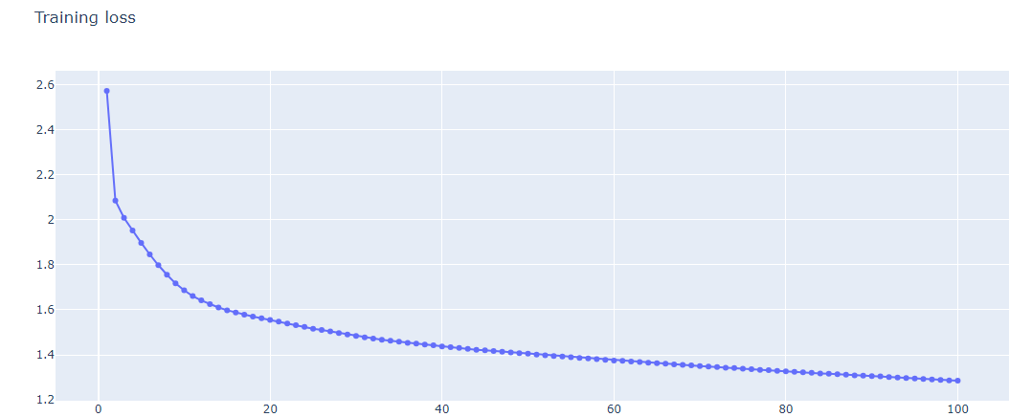
MODELLING
In modeling, we employ Recurrent Neural Networks (RNNs) to learn patterns from the dataset and generate new names. This involves tokenizing the input data, defining the RNN architecture with embedding and recurrent layers, and training the model using a categorical cross-entropy loss function and the Adam optimizer. The trained model is then used to generate new names based on seed phrases provided by the user.

Slide 10
RESULTS
The results of the name generation using Recurrent Neural Networks (RNNs) are promising. The model successfully generates novel names that are not present in the original dataset. These names exhibit diverse patterns and structures, demonstrating the effectiveness of the RNN architecture in capturing and reproducing the characteristics of the input data. Additionally, the word cloud visualization showcases the variety and creativity of the generated names, highlighting their potential applicability in various domains such as character naming in literature or branding for businesses. Overall, the results validate the feasibility and efficacy of using RNNs for name generation tasks.
SOUCE CODE LINK
https://github.com/PathmaShree/TNSDC-Generative-AI/tree/main

Slide 11
Thank you

